Slide 1

ANIMATION
SCENARIO

Slide 2
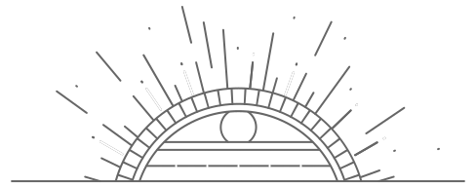
INTRODUCTION
The 3D forest animation project, using Blender software, cleverly separates into two Blender files: one for the lush forest and another for a mysterious cave with a giant human skull. This approach streamlines production and supports a rich narrative. The forest file captures the beauty of the natural world, while the cave adds intrigue.
It allows for meticulous detailing and efficient teamwork, promising a captivating and intricately designed animation. This division combines the wonders of the forest with an enigmatic twist, enhancing creativity and narrative depth. In summary, it's a strategic choice for a compelling 3D animation.

Slide 3

Immersive Dark Forest:
Create an immersive 3D model of a dark forest with intricate geometric representations, aiming to evoke a sense of mystery and intrigue
Enigmatic Skull Cave:
Develop the Skull Cave as a geometric focal point, embodying symbolism and enigma within the scene.
Dynamic Lighting and Shadows:
Employ advanced lighting techniques to set the scene's mood through the interplay of light and shadow.
Optimization for Efficiency:
Strive for efficiency in geometric models, maintaining a balance between visual fidelity and rendering performance.
Advanced Geometric Techniques:
Explore diverse geometric modeling techniques, from parametric surfaces for organic shapes to mathematical representations defining the forest and cave.

Slide 4

3D MODEL KEYPOINTS
ADD AND SCALE A PLANE FOR YOUR TERRAIN:
Begin by adding a plane to serve as the foundation of your terrain. Scale it to your desired size to establish the base of your forest scene.
Subdivide the Plane for Detail:
Enhance the plane's realism by subdividing it, creating smaller sections that can later be sculpted to add intricate details.
Enter Sculpt Mode to Shape the Terrain:
Dive into Sculpt Mode to craft the landscape. This mode offers a variety of brushes and tools to mold the terrain, allowing you to raise hills, carve valleys, and sculpt the landscape's unique features.
Enable the "A.N.T. Landscape" Add-On in Blender's Preferences:
Access Blender's preferences and activate the "A.N.T. Landscape" add-on. This powerful tool will help you generate landscapes, including the placement of trees, enriching the forest environment.
Add a Camera to Your Scene (Ctrl + 0 to Set as Active Camera):
Insert a camera into your scene to capture the perspective you desire. Make the camera the active one by using Ctrl + 0, ensuring it's ready to render your forest animation from the chosen viewpoint.
Use Particle Systems for Elements Like Grass or Leaves:
Employ Particle Systems to populate your scene with elements like grass, leaves, or other environmental features. Fine-tune the settings to achieve a realistic and immersive forest setting.
Utilize Weight Paint Mode to Control Specific Areas on Your Model:
In Weight Paint mode, you can precisely control various aspects of your model. Assign weights to specific areas of your terrain, enabling you to influence attributes like texture placement, density of vegetation, and more for a customized and lifelike forest environment.

Slide 5
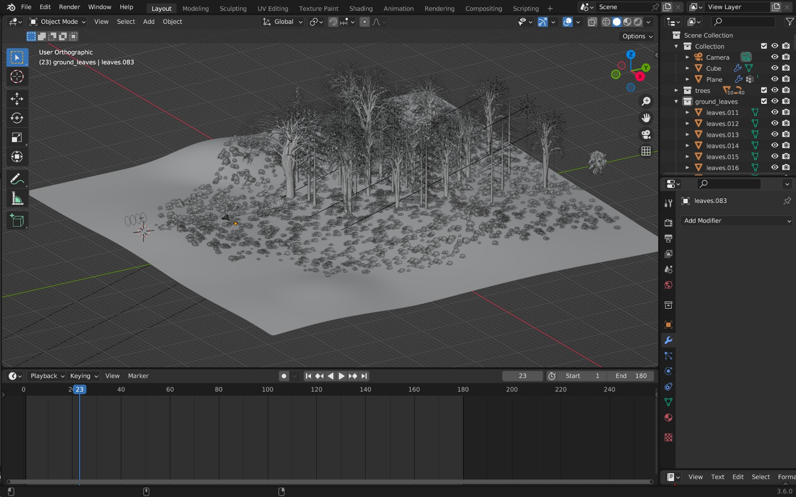

Slide 6
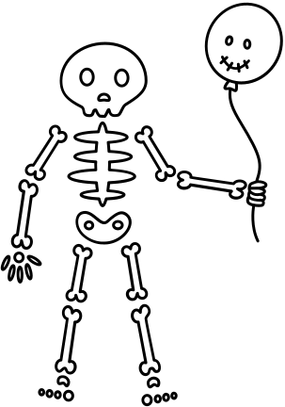
IMMERSIVE DARK FOREST
The concept of the "dark forest" aligns with the idea of an immersive forest environment.
Visuals can be used to depict geometric representations of the forest, including trees, terrain, and the overall ambiance created by lighting and shadows.
ENIGMATIC SKULL CAVE
The "Skull Cave" symbolizes a central element in the project, much like the enigmatic cave in the paragraph.
Images or sketches can emphasize the cave's geometric symbolism and its enigmatic qualities, which contribute to the narrative.

Slide 7
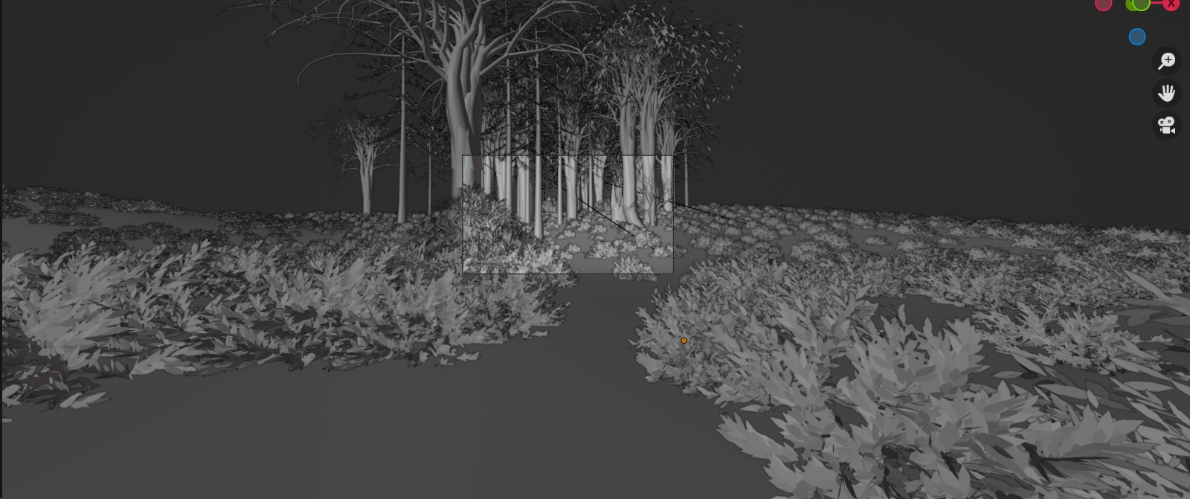

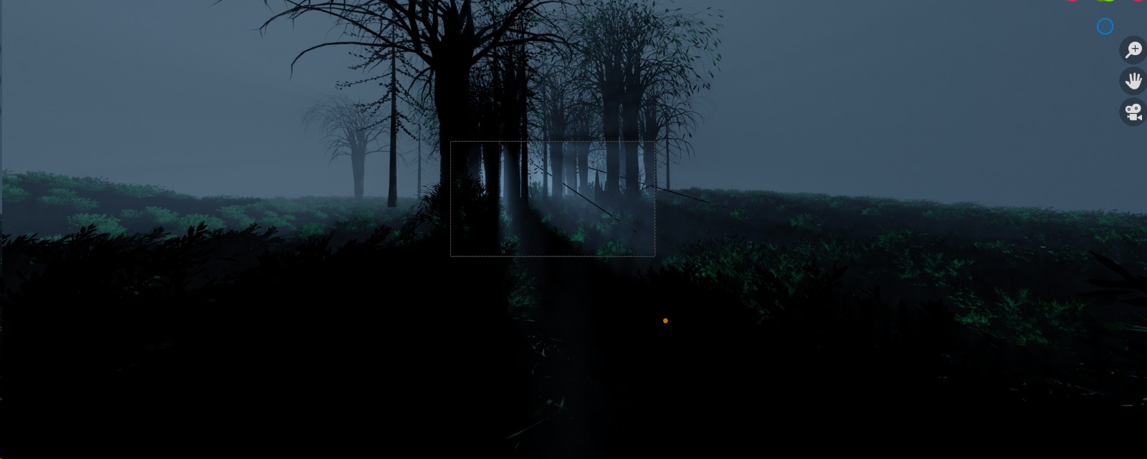

Slide 8
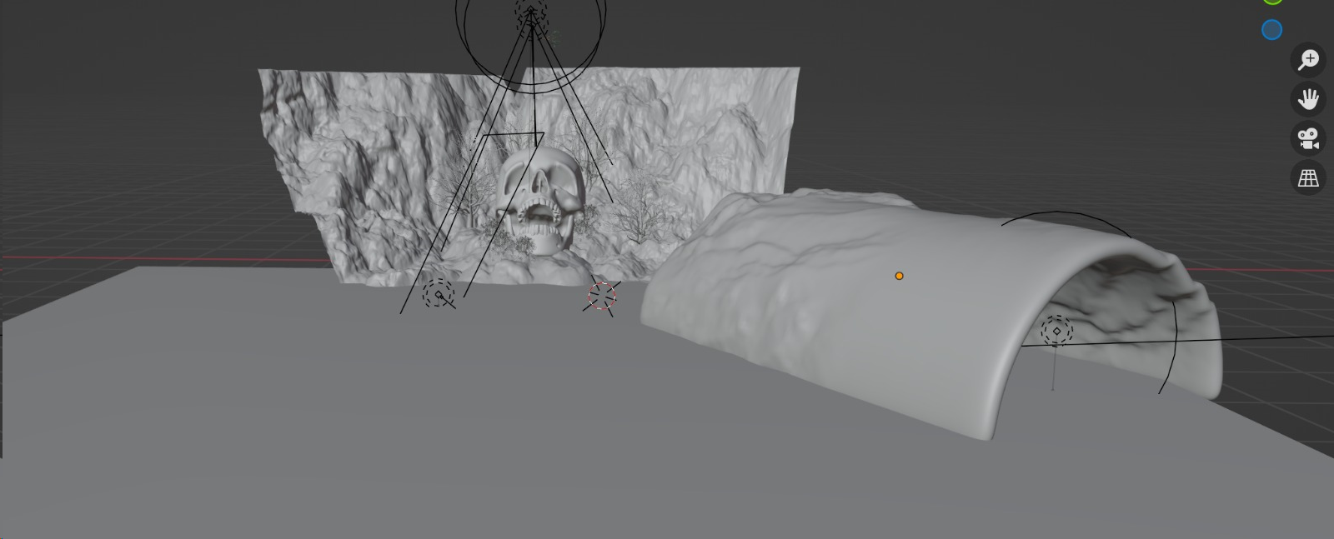
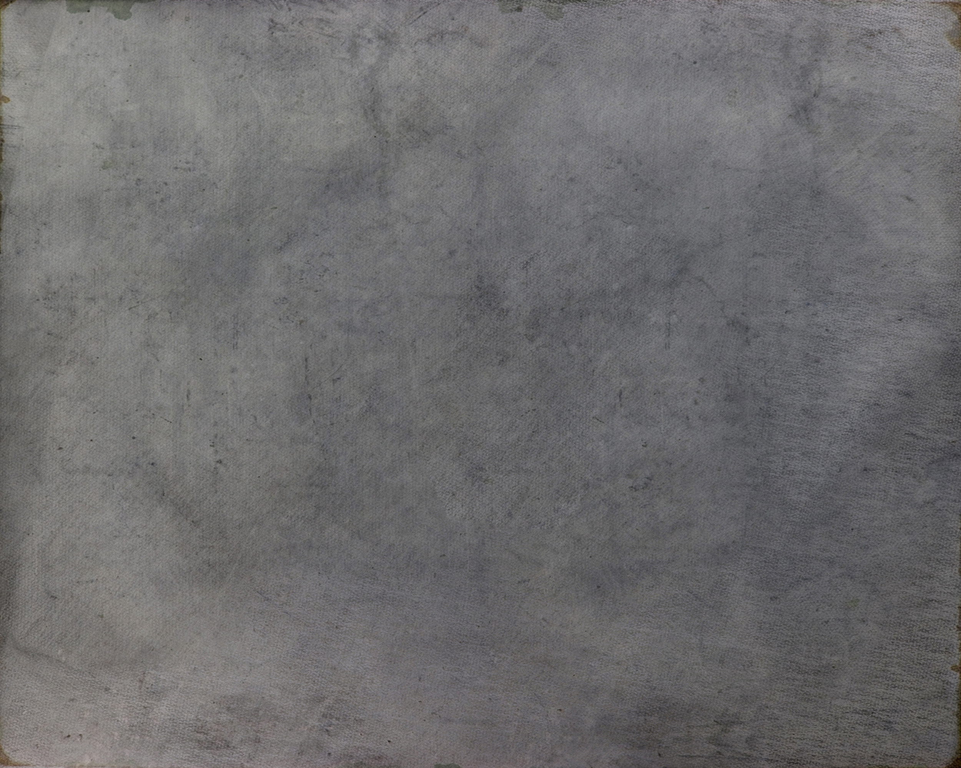
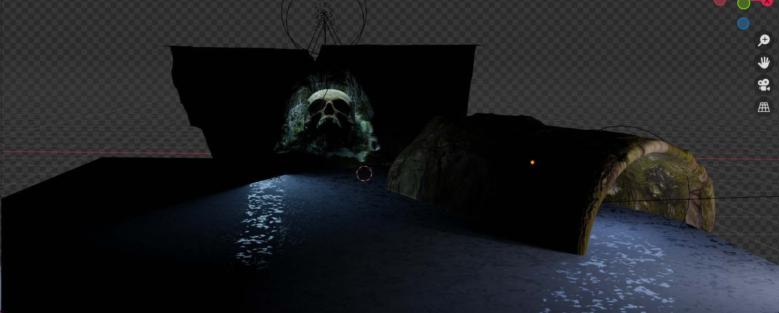

Slide 9
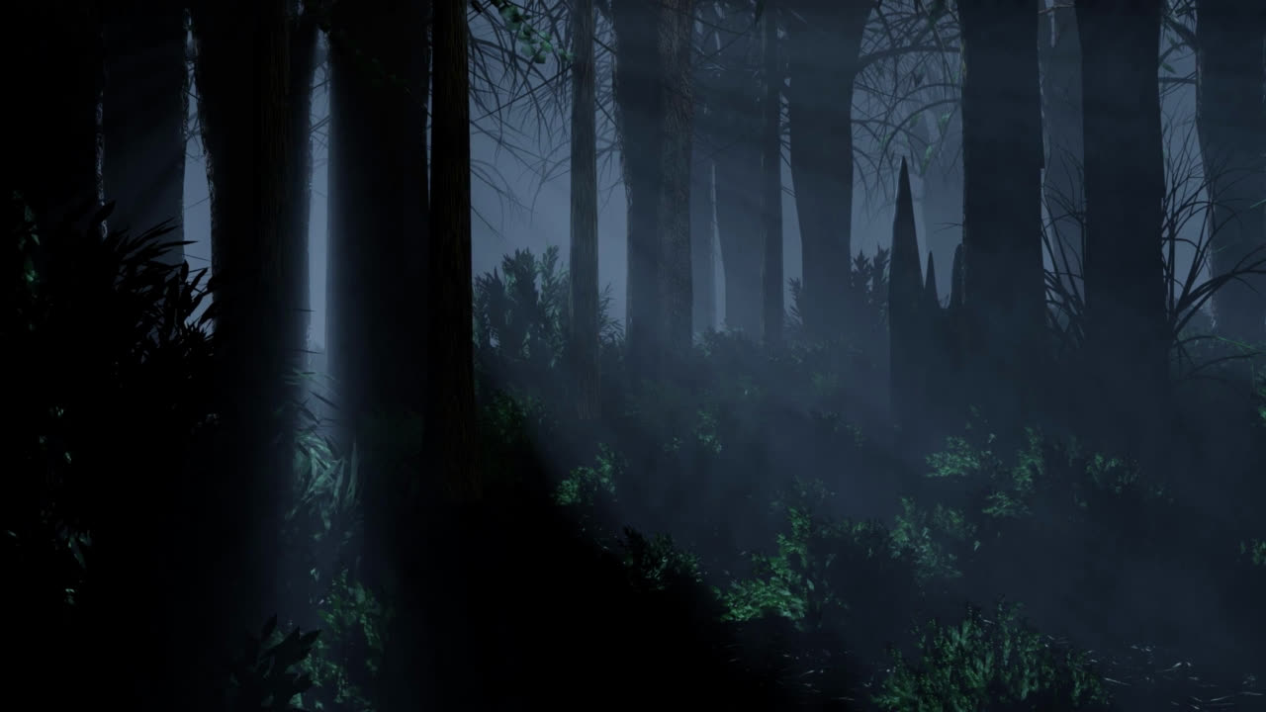

Slide 10

ADVANCED GEOMETRIC TECHNIQUES
The exploration of geometric modeling techniques resonates with the description of various geometric modeling techniques used in the project, such as parametric surfaces and mathematical representations.
Examples or illustrations can illustrate how these techniques were applied in the creation of the forest and cave.
DYNAMIC LIGHTING AND SHADOWS
The discussion of advanced lighting techniques aligns with the use of advanced lighting in the forest and cave to set the desired mood and ambiance.
Visual examples can showcase how lighting and shadows enhance the overall scene's atmosphere.
OPTIMIZATION FOR EFFICIENCY
The explanation of balancing visual fidelity and rendering performance corresponds with the project's focus on optimizing geometric models for efficiency.
Insights into how the project achieved this optimization can be shared in this slide.

Slide 11
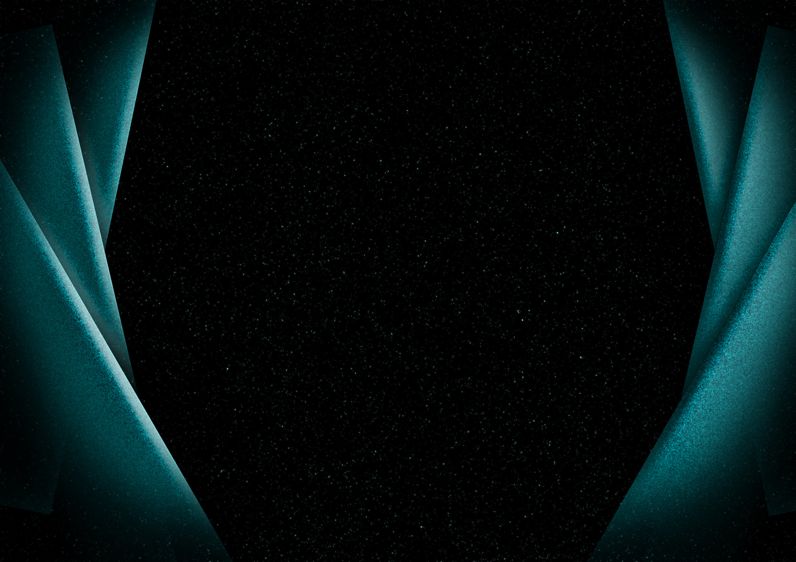
CONCLUSION
The project's strategy of compartmentalizing the 3D forest animation into separate Blender files for the forest and the enigmatic cave with its colossal skull serves as a methodical and efficient approach to animation production. This division enhances meticulous detailing, streamlines teamwork, and adds depth to the narrative. The project promises to deliver a captivating 3D animation, merging the allure of a mesmerizing forest with an element of enigma, showcasing the potential of geometric modeling in visual storytelling.

Slide 12
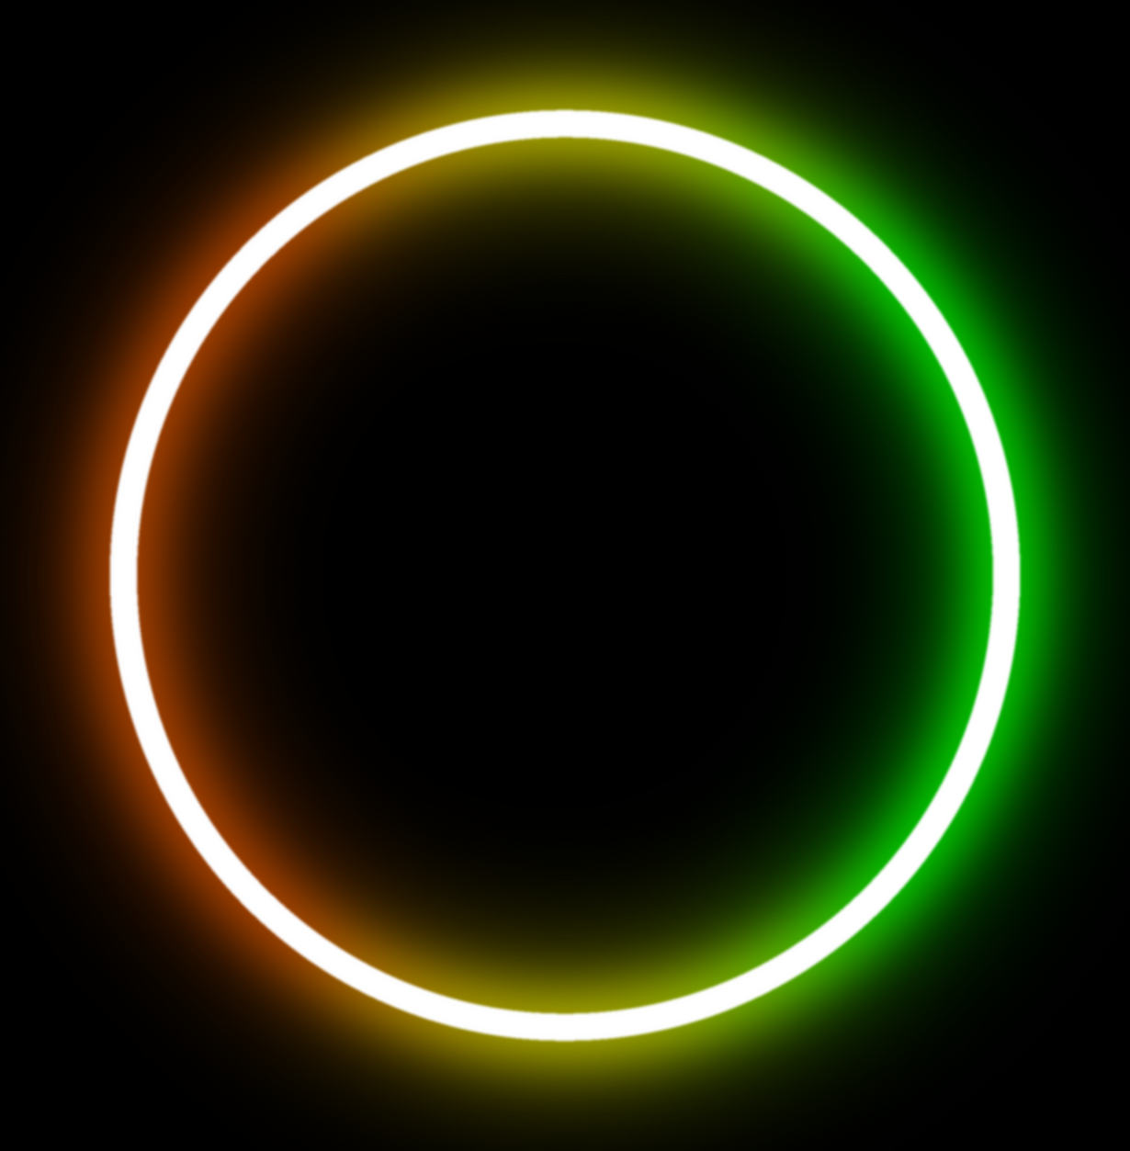

THANK YOU

